Slide 1
White Box Testing
Notes:
Workshop on "How to find software faults before our customers find them" Copyright©2007

Slide 2

Control Flow Testing
Technique
Control Flow Graphs
Control flow graphs are the foundation of control flow testing. These graphs document the module's control structure.
The paths through the graphs are analyzed, and test cases are created from that analysis.
Notes:
Workshop on "How to find software faults before our customers find them" Copyright©2007

Slide 3
Control Flow Testing
Levels of Coverage
By "coverage" we mean the percentage of the code that has been tested vs. that which is there to test.
In control flow testing we define coverage at a number of different levels.
Notes:
Workshop on "How to find software faults before our customers find them" Copyright©2007

Slide 4
Control Flow Testing
Level 1
The lowest coverage level is "100% statement coverage“.
While this may seem like a reasonable goal, many defects may be missed with this level of coverage. Consider the following code snippet:
if (a>0) {x=x+1;}
if (b==3) {y=0;}
Notes:
Workshop on "How to find software faults before our customers find them" Copyright©2007

Slide 5
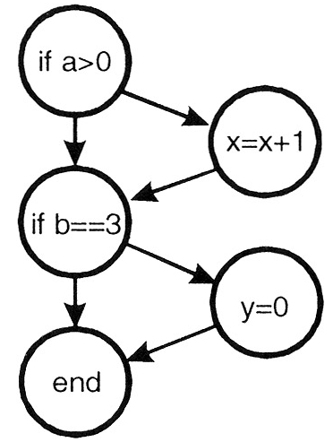
Control Flow Testing
This code can be represented in graphical form as:
Fig. 3: Graphical representation of the two-line code snippet.
Notes:
Workshop on "How to find software faults before our customers find them" Copyright©2007

Slide 6
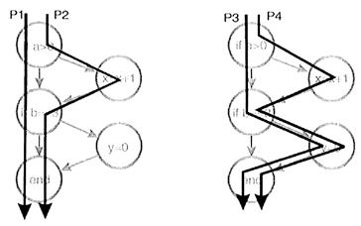
Control Flow Testing
These two lines of code implement four different paths of execution:
Fig. 4: Four execution paths.
Notes:
Workshop on "How to find software faults before our customers find them" Copyright©2007

Slide 7
Control Flow Testing
While a single test case is sufficient to test every line of code in this module (ex. a=6 and b=3), it is apparent that this level of coverage will miss testing many paths.
Statement coverage may be difficult to achieve in practice.
Often modules have code that is executed only in exceptional circumstances-low memory, full disk, unreadable files, lost connections, etc.
Testers may find it difficult or even impossible to simulate these circumstances.
Notes:
Workshop on "How to find software faults before our customers find them" Copyright©2007

Slide 8
Control Flow Testing
Level 0
There is a level of coverage below "100% statement coverage." Which is defined as "test whatever you test; let the users test the rest."
Regarding this level of coverage, Boris Beizer wrote
"testing less than this [100% statement coverage] for new software is unconscionable and should be criminalized. ...
In case we haven't made ourself clear, ... untested code in a system is stupid, shortsighted, and irresponsible."
Notes:
Workshop on "How to find software faults before our customers find them" Copyright©2007

Slide 9
Control Flow Testing
Level 2
"100% decision coverage" also called "branch coverage." At this level enough test cases are written so that each decision that has a TRUE and FALSE outcome is evaluated at least once.
In the previous example this can be achieved with how many test cases?
Following two test cases for decion/branch coverage:
(a=-2, b=2 and a=4, b=3).
Notes:
Workshop on "How to find software faults before our customers find them" Copyright©2007

Slide 10
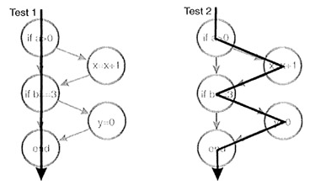
Control Flow Testing
Fig. 5: Two test cases that yield 100% decision coverage.
Case statements with multiple exits would have tests for each exit.
Note that decision coverage does not necessarily guarantee path coverage but it does guarantee statement coverage.
Notes:
Workshop on "How to find software faults before our customers find them" Copyright©2007

Slide 11
Control Flow Testing
Level 3 : “100% condition coverage”
Not all conditional statements are as simple as the ones previously shown. Consider these more complicated statements:
if (a>0 && c==1) {x=x+1;}
if (b==3 || d<0) {y=0;}
To be TRUE, the first statement requires a greater than 0 and c equal 1. The second requires b equal 3 or d less than 0.
In the first statement if the value of a were set to 0 for testing purposes then the c==1 part of the condition would not be tested.
Notes:
Workshop on "How to find software faults before our customers find them" Copyright©2007

Slide 12
Control Flow Testing
Enough test cases are written so that each condition that has a TRUE and FALSE outcome that makes up a decision is evaluated at least once.
This level of coverage can be achieved with two test cases (a>0, c=1, b=3, d<0 and a≤0, c≠1, b≠3, d≥0).
Condition coverage is usually better than decision coverage because every individual condition is tested at least once while decision coverage can be achieved without testing every condition.
Notes:
Workshop on "How to find software faults before our customers find them" Copyright©2007

Slide 13
Control Flow Testing
Level 4 : “100% decision/ condition coverage”
Consider this situation:
if(x&&y) {conditionedStatement;}
// note: && indicates logical AND
We can achieve condition coverage with two test cases (x=TRUE, y=FALSE and x=FALSE, y=TRUE) but with these conditionedStatement will never be executed.
In 100% decision/ condition coverage level test cases are created for every condition and for every decision.
Notes:
Workshop on "How to find software faults before our customers find them" Copyright©2007

Slide 14
Control Flow Testing
Level 5 : “100% multiple condition coverage”
Multiple condition coverage requires test cases that ensure each possible combination of inputs to a decision is executed at least once.
Multiple condition coverage requires exhaustive testing of the input combinations to a decision.
Multiple condition coverage is the most desirable structural coverage measure; but, it is impractical for many cases.
To be even more thorough, consider how the programming language compiler actually evaluates the multiple conditions in a decision. Use that knowledge to create test cases yielding “100% multiple condition coverage”.
if (a>0 && c==1) {x=x+1;}
if (b==3 || d<0) {y=0;}
// note: || means logical OR
Notes:
Workshop on "How to find software faults before our customers find them" Copyright©2007

Slide 15
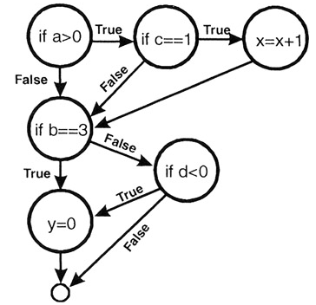
Control Flow Testing
will be evaluated as:
Fig. 6: Compiler evaluation of complex conditions.
Notes:
Workshop on "How to find software faults before our customers find them" Copyright©2007

Slide 16
Control Flow Testing
This level of coverage can be achieved with four test cases:
a>0, c=1, b=3, d<0
a≤0, c=1, b=3, d≥0
a>0, c≠1, b≠3, d<0
a≤0, c≠1, b≠3, d≥0
if (a>0 && c==1) {x=x+1;}
if (b==3 || d<0) {y=0;}
// note: || means logical OR
Achieving 100% multiple condition coverage also achieves decision coverage, condition coverage, and decision/condition coverage.
Note that multiple condition coverage does not guarantee path coverage.
Notes:
Workshop on "How to find software faults before our customers find them" Copyright©2007

Slide 17
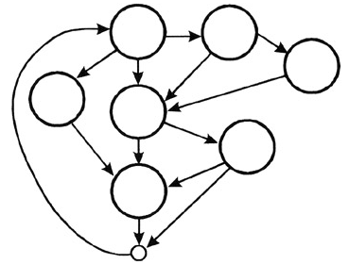
Control Flow Testing
Level 7 : “100% path coverage”
For code modules without loops the number of paths is generally small.
For modules with loops, the number of paths can be enormous and thus pose an intractable testing problem.
Fig. 7: An interesting flow diagram with many, many paths.
Notes:
Workshop on "How to find software faults before our customers find them" Copyright©2007

Slide 18
Control Flow Testing
Level 6
When a module has loops such that the number of paths is infinite, a significant but meaningful reduction can be made by limiting loop execution to a small number of cases.
1st case : execute loop zero time
2nd case : execute loop one time
3rd case : execute loop n times
4th case : execute loop n+1 time
We can also have loop to execute m-1 & m +1 times
Before beginning control flow testing, an appropriate level of coverage should be chosen.
Notes:
Workshop on "How to find software faults before our customers find them" Copyright©2007

